Slide 1
Artificial Intelligence (Machine Learning & Deep Learning)
{
Logistic Regression (Multiclass Classification)
}
...

Slide 2
Contents of Day 15
Recap & introduction | Moving from Python OOP to Data Science. Why AI needs data.
Core Thoery | Multiclass Logistic Regression Predicting 3+ categories (e.g., Safe, DDoS, or Malware). The SoftMax Function.
Lab Practice | Practical coding tasks implementing method
Advance Lab | Understanding the logic with real world examples.
Wrap-up & Q&A | Debugging tips along with Q&A and suggestion

Slide 3
From Binary to Multiclass Classification
Before: We predicted two categories (Safe or DDoS).
Today: We predict three or more categories.
Example - Network Traffic Classification:
* Class 0: Normal Traffic
* Class 1: DDoS Attack
* Class 2: Malware Injection
The problem: Sigmoid only handles 2 classes. We need a new function.

Slide 4
The Softmax Function - The Upgrade
Sigmoid limitation: Only outputs two probabilities (0 or 1).
SoftMax solution: Outputs probability for EACH class.
Golden rule: All probabilities add up to exactly 100% (1.0).
Example:
Class 0: 0.7 (70% probability)
Class 1: 0.2 (20% probability)
Class 2: 0.1 (10% probability)
Total: 1.0 (100%)

Slide 5

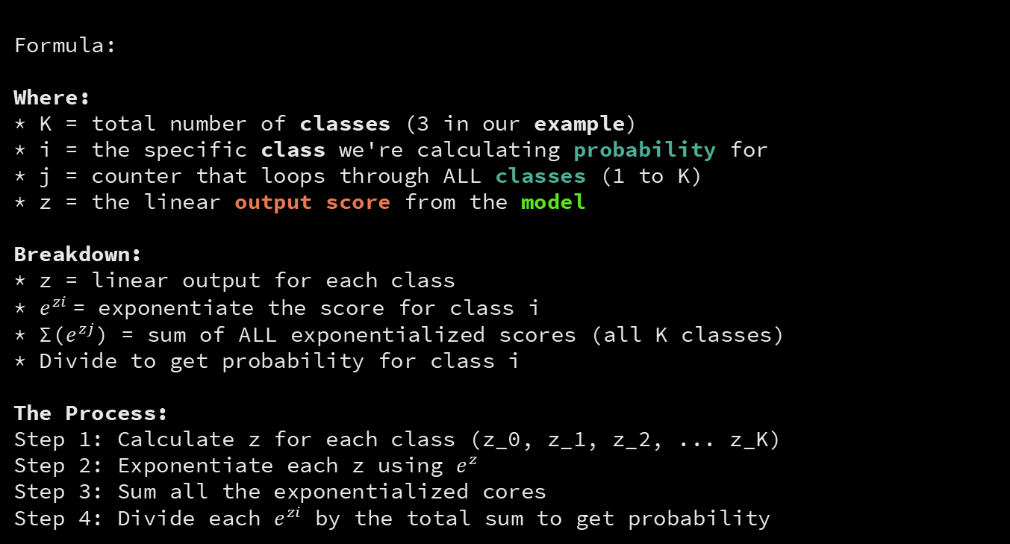
The Softmax Formula Explained
Formula:
Where:
* K = total number of classes (3 in our example)
* i = the specific class we're calculating probability for
* j = counter that loops through ALL classes (1 to K)
* z = the linear output score from the model
Breakdown:
* z = linear output for each class
* $e^{zi}$= exponentiate the score for class i
* Σ($e^{zj}$) = sum of ALL exponentialized scores (all K classes)
* Divide to get probability for class i
The Process:
Step 1: Calculate z for each class (z_0, z_1, z_2, ... z_K)
Step 2: Exponentiate each z using $e^{z}$
Step 3: Sum all the exponentialized cores
Step 4: Divide each $e^{zi}$ by the total sum to get probability

Slide 6
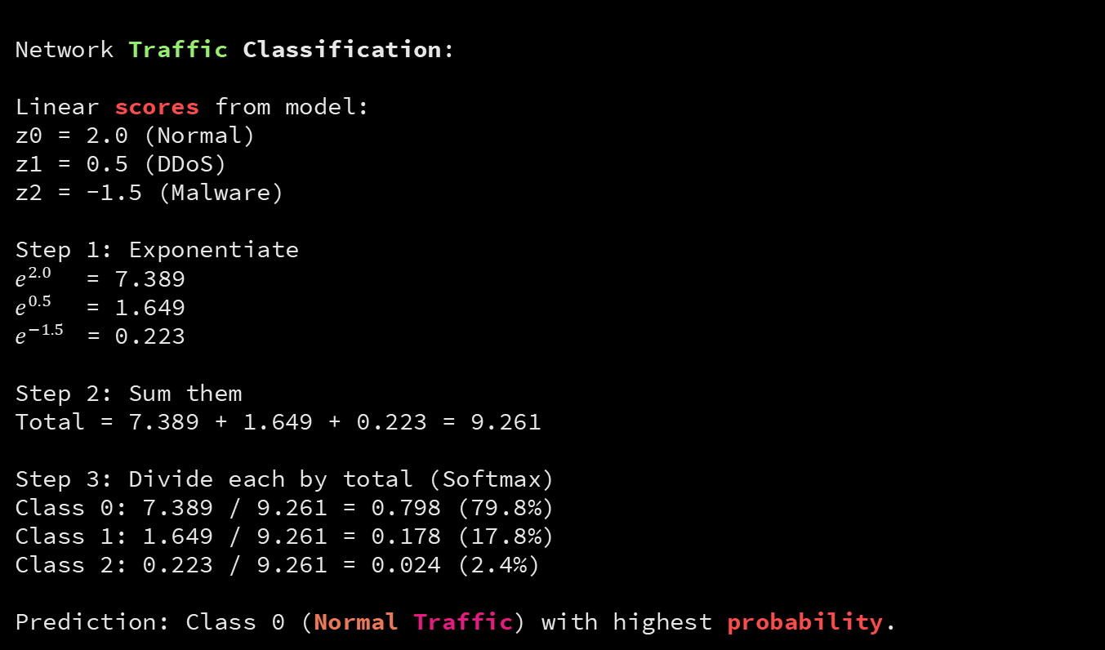
Softmax Example - Step by Step
Network Traffic Classification:
Linear scores from model:
z0 = 2.0 (Normal)
z1 = 0.5 (DDoS)
z2 = -1.5 (Malware)
Step 1: Exponentiate
$e^{2.0}$ = 7.389
$e^{0.5}$ = 1.649
$e^{−1.5}$= 0.223
Step 2: Sum them
Total = 7.389 + 1.649 + 0.223 = 9.261
Step 3: Divide each by total (Softmax)
Class 0: 7.389 / 9.261 = 0.798 (79.8%)
Class 1: 1.649 / 9.261 = 0.178 (17.8%)
Class 2: 0.223 / 9.261 = 0.024 (2.4%)
Prediction: Class 0 (Normal Traffic) with highest probability.

Slide 7
Why Softmax Works for Multiclass
Each class gets a probability.
The class with highest probability wins.
The probabilities are normalized (always sum to 1.0).
This ensures:
* No class can have probability > 1.0
* No class can have negative probability
* All possibilities sum to 100%
Perfect for multi-category decisions.

Slide 8
Softmax vs Sigmoid Comparison
Sigmoid (Binary):
Input: 1 linear score
Output: 2 probabilities (class 0 and class 1)
Use case: Two-category problems
Softmax (Multiclass):
Input: K linear scores (one per class)
Output: K probabilities (one per class)
Use case: 3+ category problems
Both use Gradient Descent to optimize weights.
The function changes, the algorithm stays the same.

Slide 9
What is a Solver - Gradient Descent vs L-BFGS
A Solver is the algorithm that finds perfect weights.
Standard Gradient Descent: You feel the slope, take one step, feel again, take another step. It works but takes thousands of tiny steps to reach the bottom.
L-BFGS: You have a math equation that calculates the curvature of the entire mountain. Because it knows the shape of the bowl, it takes massive, accurate leaps. It solves in 100 steps instead of 10,000.
Result: L-BFGS is 100× faster than standard Gradient Descent.

Slide 10
Why L-BFGS Matters - Limited-Memory Genius
Standard curvature needs a giant Hessian matrix in RAM. Processing 5 million API logs would consume all server memory and crash.
The "L" (Limited-Memory) cheats: It doesn't store the whole matrix. It only remembers the last few steps, guesses the curvature, clears memory as it goes.
Result: Lightning-fast, highly accurate, won't crash your server on massive data.
Use solver='lbfgs' in production. Always.

Slide 11
Thank You for Your Focus Today!
What was the most confusing part of today's lab?
Waleed Khan (Robotics Engineer | Senior Python Developer)
Email: 0xcloudcoder@gmail.com Contact: +923126008702
}
*

